Slide 1
Data Converter for diode data
September 6, 2012
Notes:
ProPlus Design Solutions, Inc.

Slide 2
Introduction
This tutorial gives a step-by-step instruction on the diode data converter’s usage.
  Step 1: Put data or data folder to the converter’s directory
  Step 2: How to convert
  Step 3: Run the converter and check the results

Slide 3
Step 1: Put data or data folder to the converter’s directory
The converter is a console application.
First put the data or data folder to the converter’s directory. The converter will walk the current directory and search the data file by the file’s extension.

Slide 4
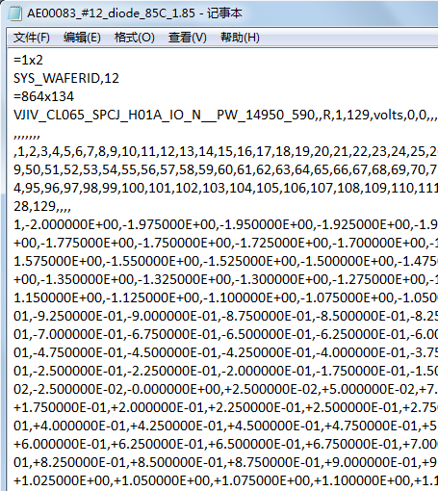
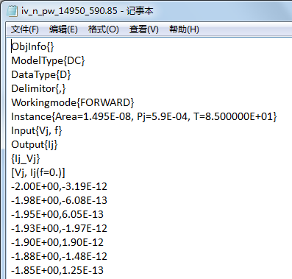
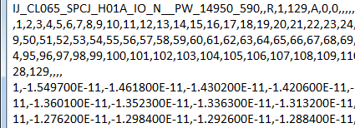
Diode IV
The suffix is the temperature
Change unit from um² to m²
……

Slide 5
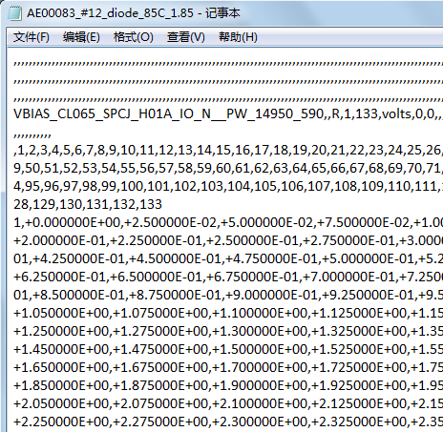
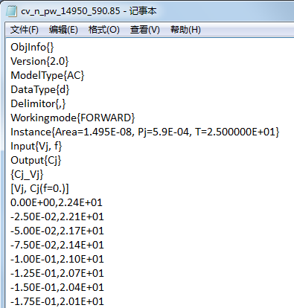
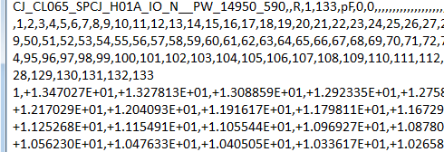
Diode CV
Revise the bias to negative for CV
……

Slide 6
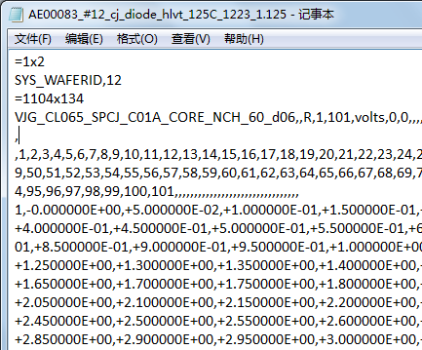
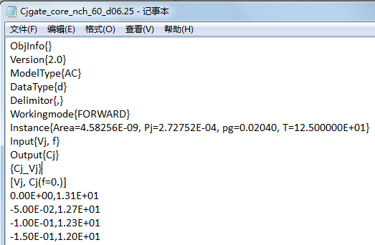
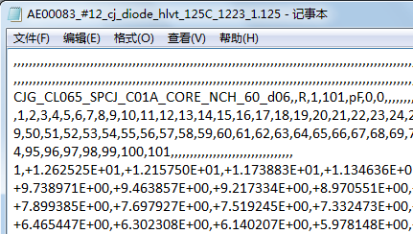
Huali Cjgate CV
Revise the bias to negative for CV

Slide 7

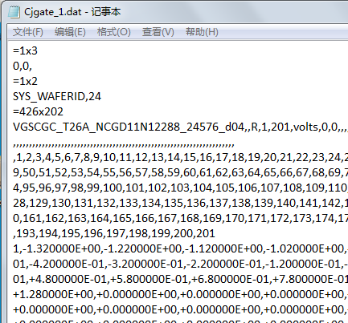
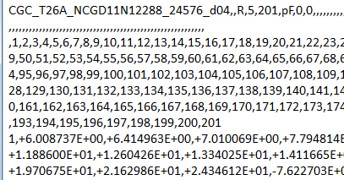
SMIC Cjgate CV
If there is F1, f=1e6; if there is no F1, f=1e5
Revise the bias to negative for CV
Keep the first group data

Slide 8
Step 3: Run the converter and check the result
Run the converter the results will be put into the folder named ‘Converted_data’ in current directory.
Load the data into BPP to check the converted data.

Slide 9
You have completed all the steps of this tutorial.
Congratulations!
Notes:
ProPlus Design Solutions, Inc.

